Slide 1

Parameterized Complexity of
Small Decision Tree Learning.
Ordyniak, S., & Szeider, S. (2021).
Proceedings of the AAAI Conference on Artificial Intelligence, 35 (7), 6454-6462.

Slide 2
Parameterized Complexity of
Small Decision Tree Learning.
let’s break it down!
Ordyniak, S., & Szeider, S. (2021).
Proceedings of the AAAI Conference on Artificial Intelligence, 35 (7), 6454-6462.

Slide 3
Parameterized
Complexity of
Small Decision Tree Learning.
Ordyniak, S., & Szeider, S. (2021).
Proceedings of the AAAI Conference on Artificial Intelligence, 35 (7), 6454-6462.

Slide 4
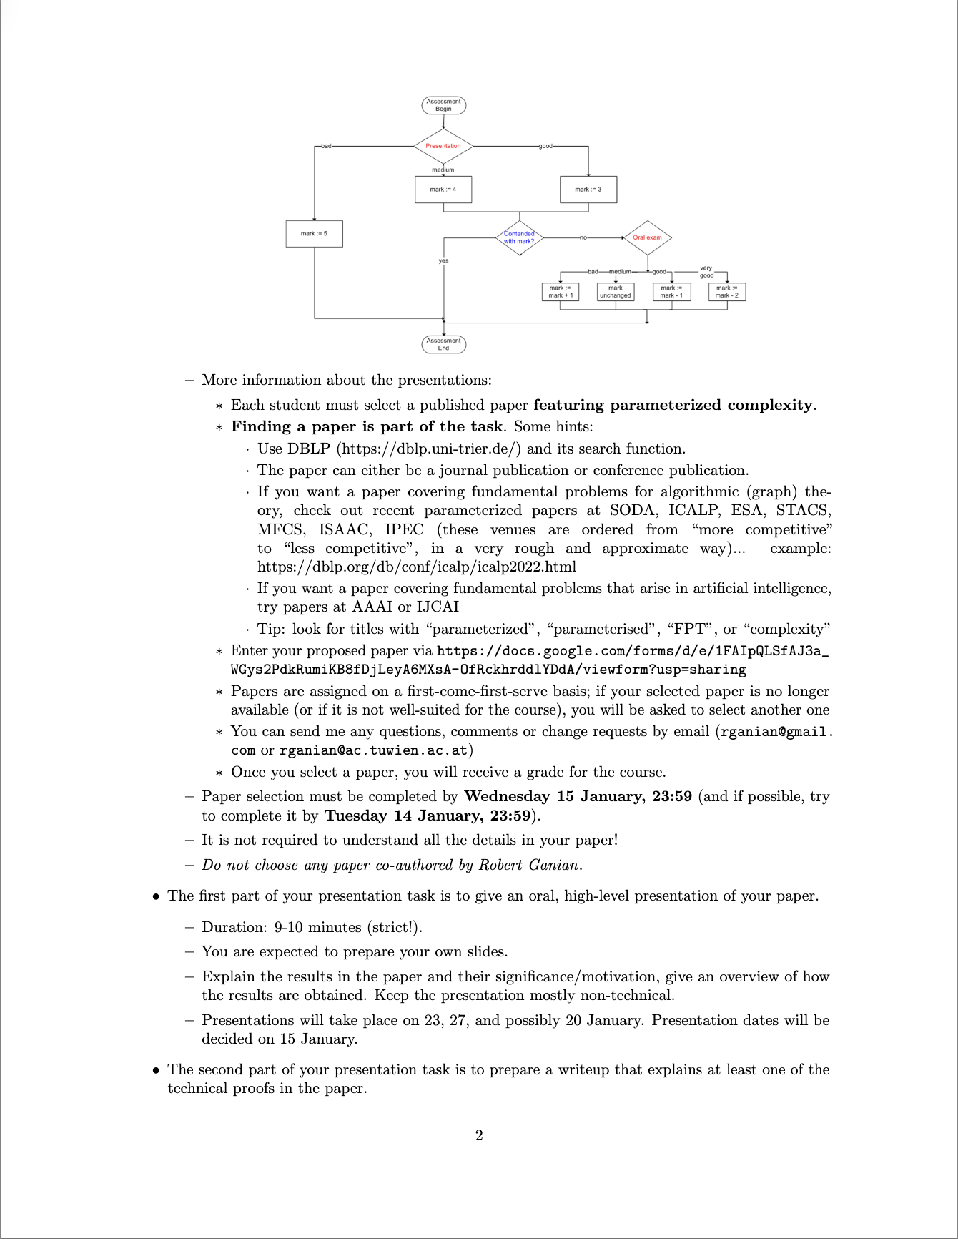
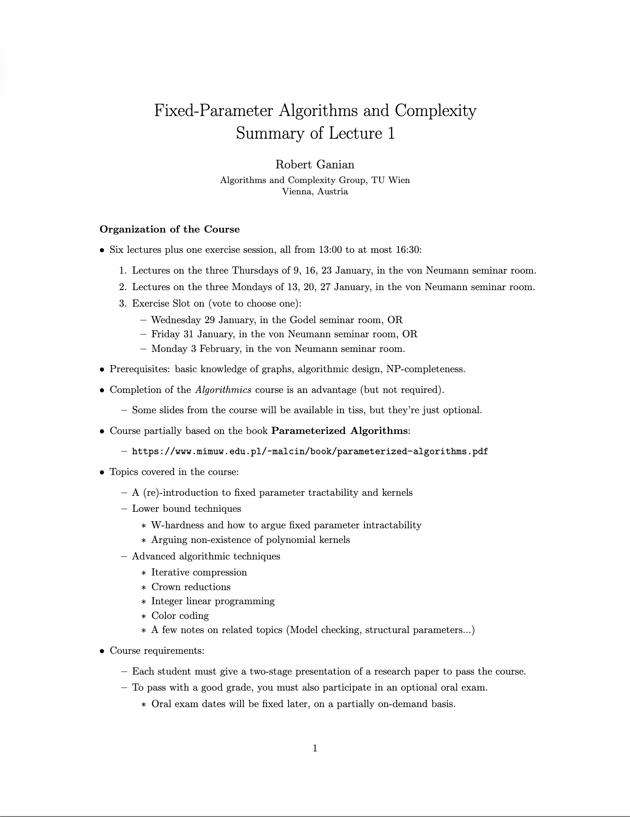
grading schema

Slide 5
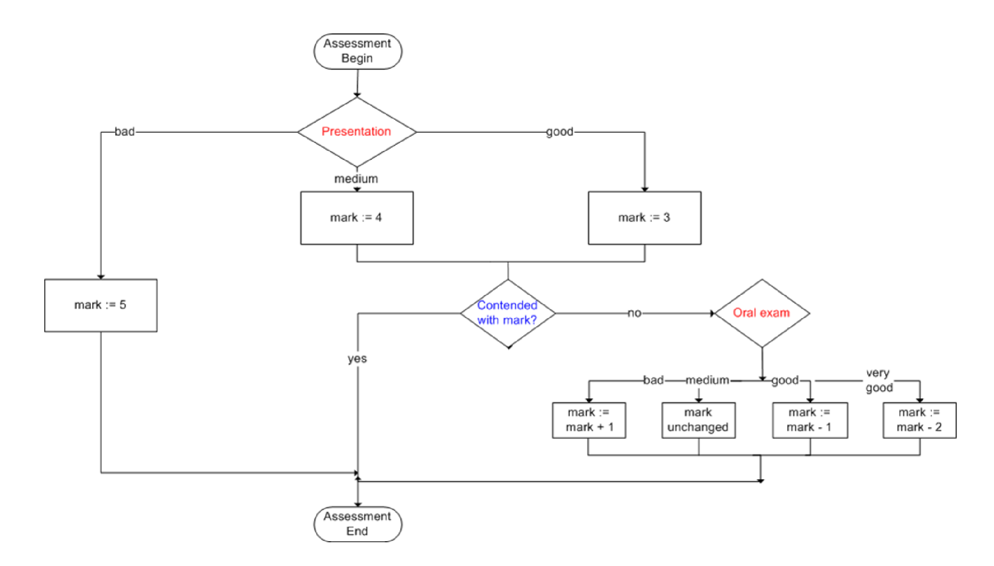

Slide 6
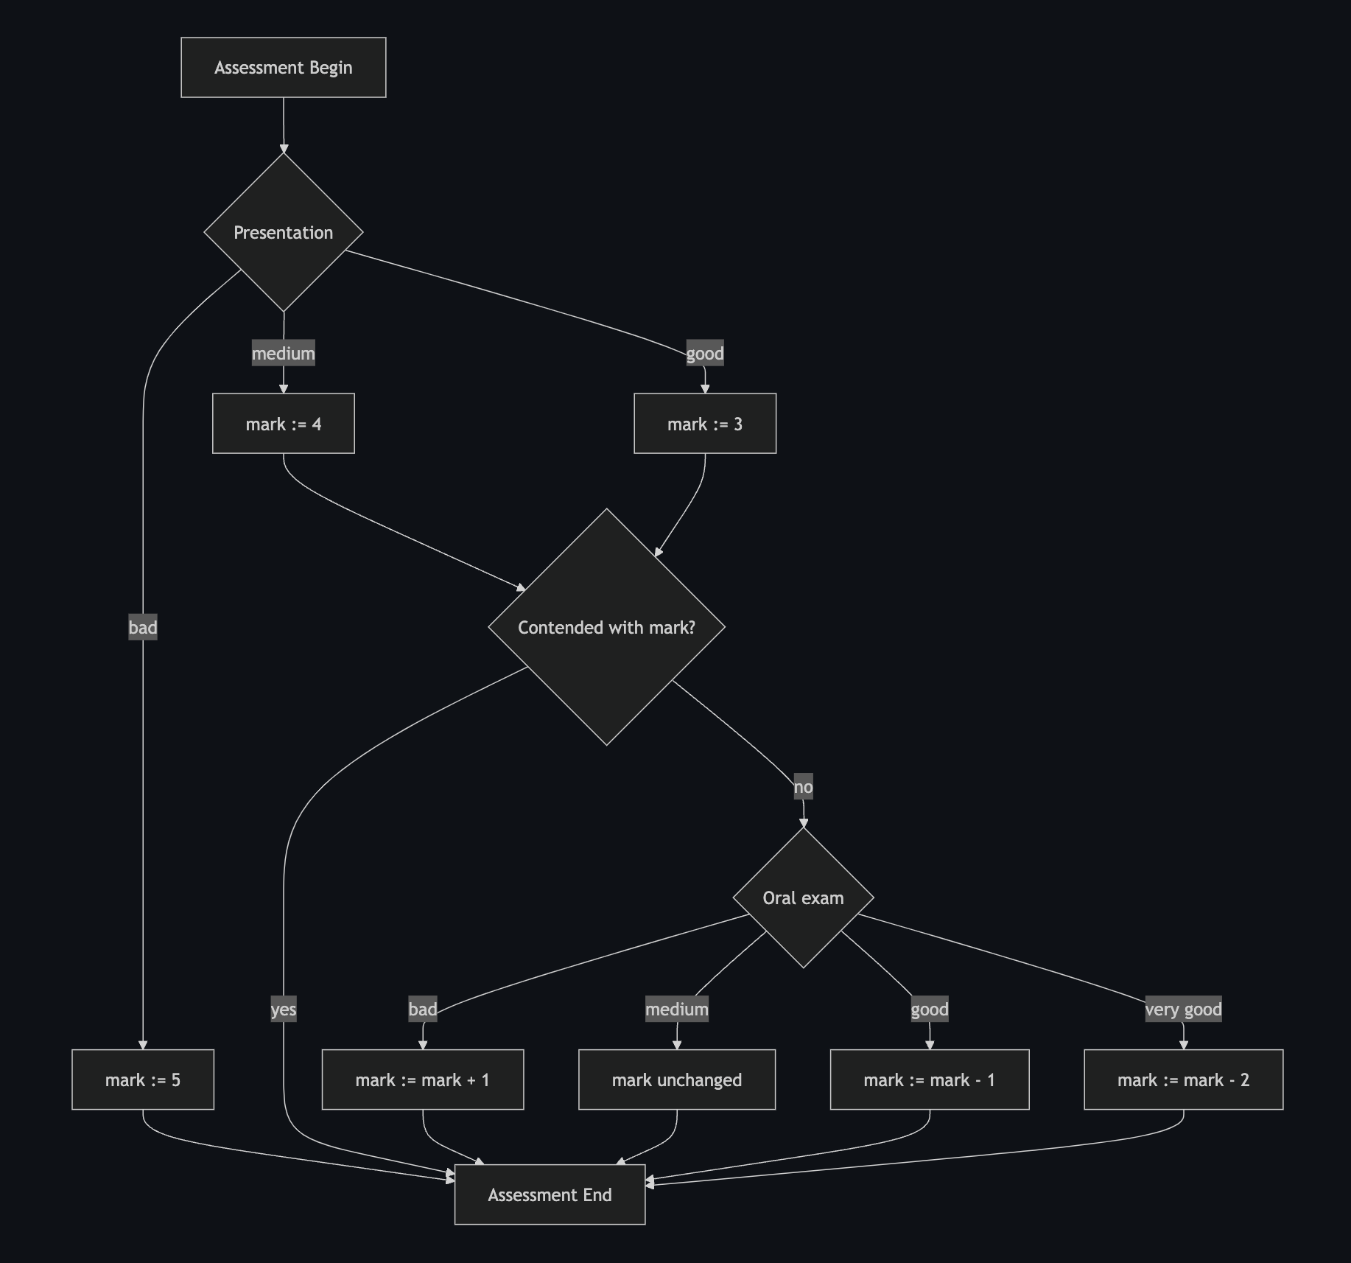
code: https://github.com/sueszli/optimal-tree-solver/blob/main/docs/grading.md

Slide 7
too many paths per vertex
code: https://github.com/sueszli/optimal-tree-solver/blob/main/docs/grading.md

Slide 8
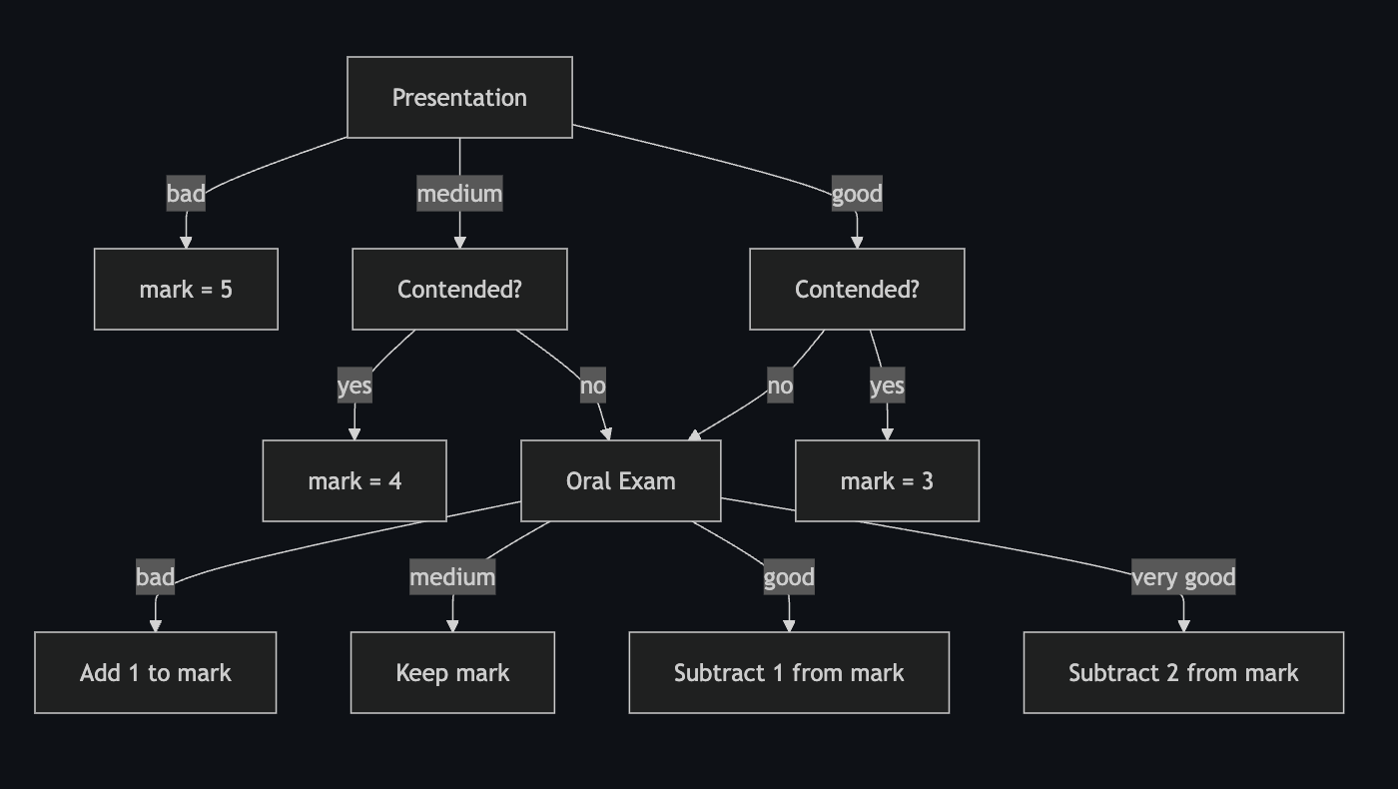
code: https://github.com/sueszli/optimal-tree-solver/blob/main/docs/grading.md

Slide 9
labels need arithmetic
code: https://github.com/sueszli/optimal-tree-solver/blob/main/docs/grading.md

Slide 10
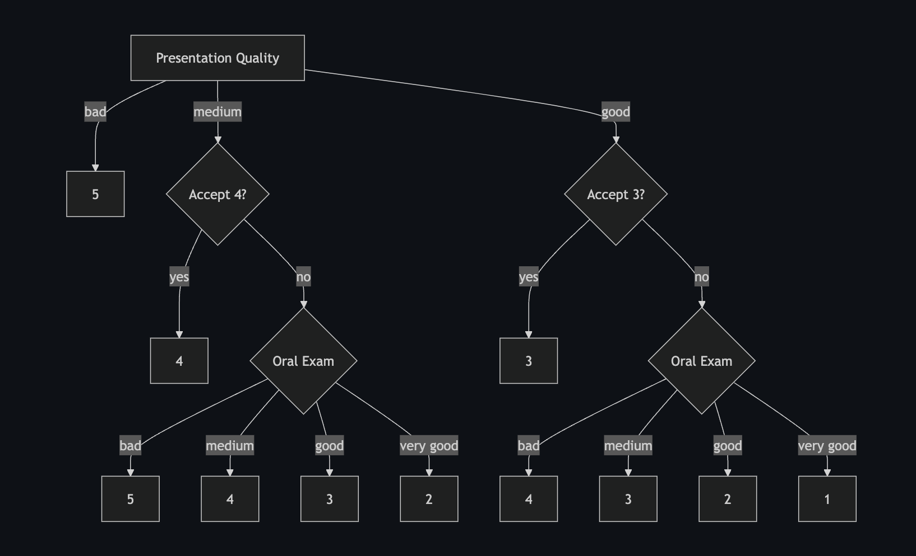
yup, looks right!
code: https://github.com/sueszli/optimal-tree-solver/blob/main/docs/grading.md

Slide 11
data schema: [presentation grade, accept grade 3/4, oral grade]
labels: [1, 2, 3, 4, 5]
but boolean in paper
split: we try to find a perfect decision boundary, full acc.
no entropy metrics, just brute forcing combinations.
tree depth: 3 (longest root-to-leaf path)
tree size: 8 (count of non-leaf nodes)

Slide 12
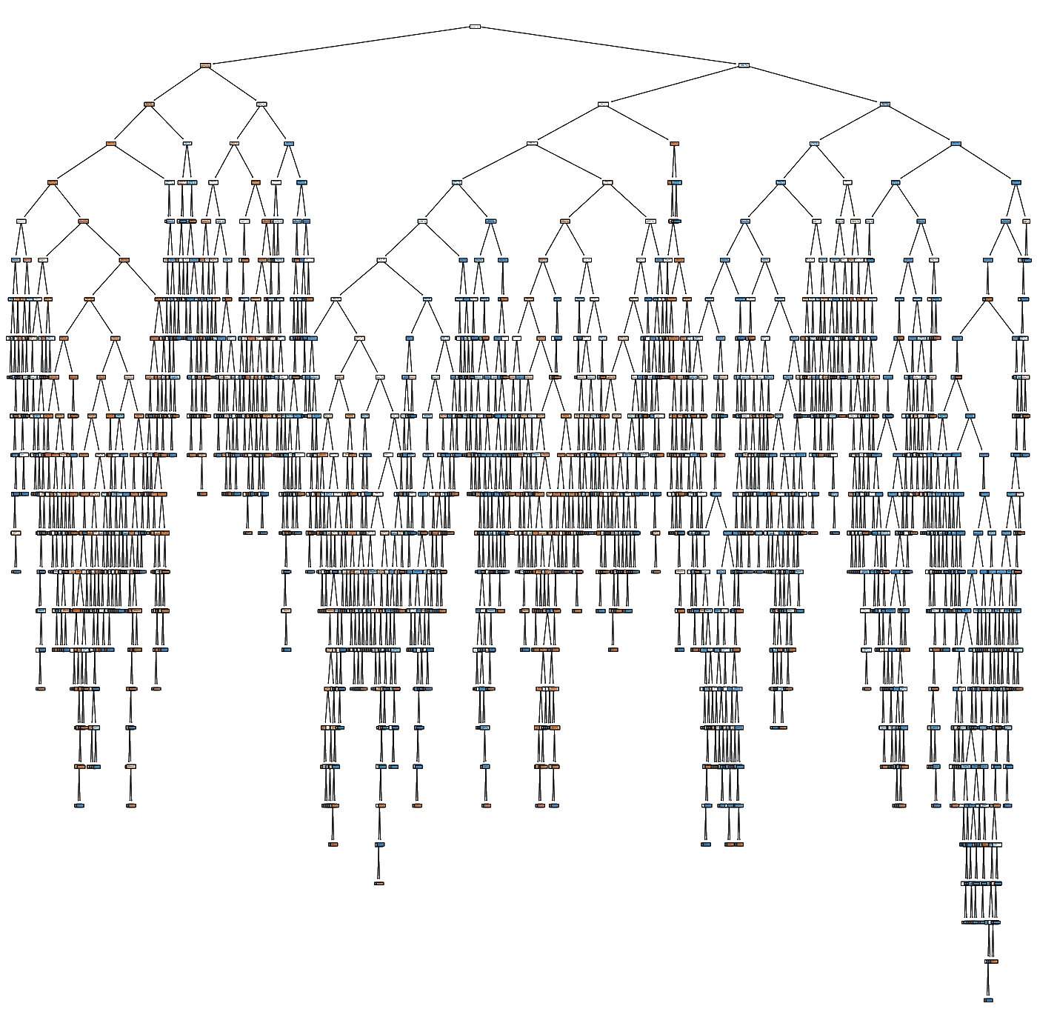
we prefer decision trees to be small in depth/size:
- easier to interpret
- use fewer, more robust features

Slide 13
problems:
- minimum decision tree size (DTS)
- minimum decision tree depth (DTD)
decision problems.
but our algorithms also provide the solution.

Slide 14
Parameterized
Complexity of
Small Decision Tree Learning.
Ordyniak, S., & Szeider, S. (2021).
Proceedings of the AAAI Conference on Artificial Intelligence, 35 (7), 6454-6462.

Slide 15
traditional complexity theory:
finding minimal (size/depth) decision trees is NP-hard (Hyafil & Rivast, 1976).
- no known polynomial-time algorithm exists for all instances unless P=NP.
- finding solution is computationally intractable for large inputs.
parameterized complexity theory:
contribution of this paper.
problem is fixed-parameter tractable.
= problem is feasible for small problem parameter values, despite NP-hardness.
= runtime is polynomial in the input size, but exponential in some problem parameters.

Slide 16
traditional complexity theory:
finding minimal (size/depth) decision trees is NP-hard (Hyafil & Rivast, 1976).
- no known polynomial-time algorithm exists for all instances unless P=NP.
- finding solution is computationally intractable for large inputs.
parameterized complexity theory:
contribution of this paper.
problem is fixed-parameter tractable.
= problem is feasible for small problem parameter values, despite NP-hardness.
= runtime is polynomial in the input size, but exponential in some problem parameters.
how do you find these?

Slide 17

problem becomes fixed-parameter tractable when parametrized by:
- solution size/depth
- maximum domain size (max value range of any feature)
- maximum hamming distance (max num of features that differ between any 2 examples.)
might be redundant
some exponential function
polynomial
in the input size

Slide 18
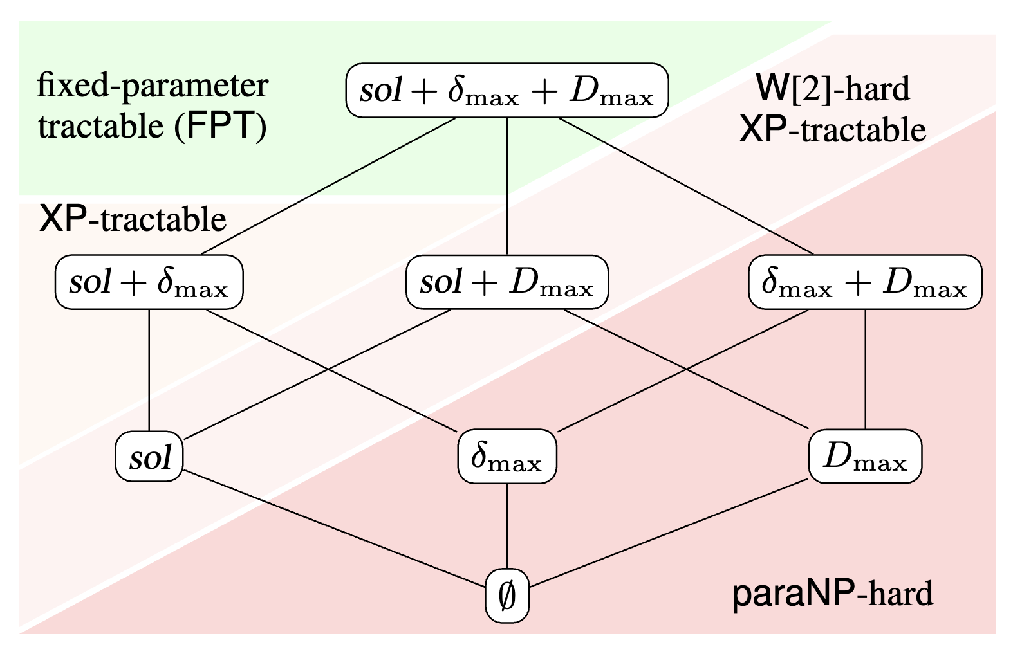
to here?
how did the authors
find the right problem parameters?
complexity landscape
how to get from here

Slide 19
deconstruction of intractability:
find naturally occurring problem parameters
that strongly influence the problem’s runtime (practical solvability).
- mostly trial and error.
- reductions to other problems.
- analyzing practical usage.
how did the authors
find the right problem parameters?

Slide 20
solution size:
- from problem definition
max domain size:
- determines search space for decision boundaries
max hamming dist:
- is the size of largest set in “hitting set” reduction
- very small in practice
how did the authors
find the right problem parameters?

Slide 21
The optimal
decision tree algorithm.

Slide 22
way harder
1) feature selection
2) tree construction
code: https://github.com/sueszli/optimal-tree-solver/blob/main/src/mindt.py

Slide 23
2) tree construction
- input: examples, tree size + set of features
- output: minimal tree (or null)

Slide 24
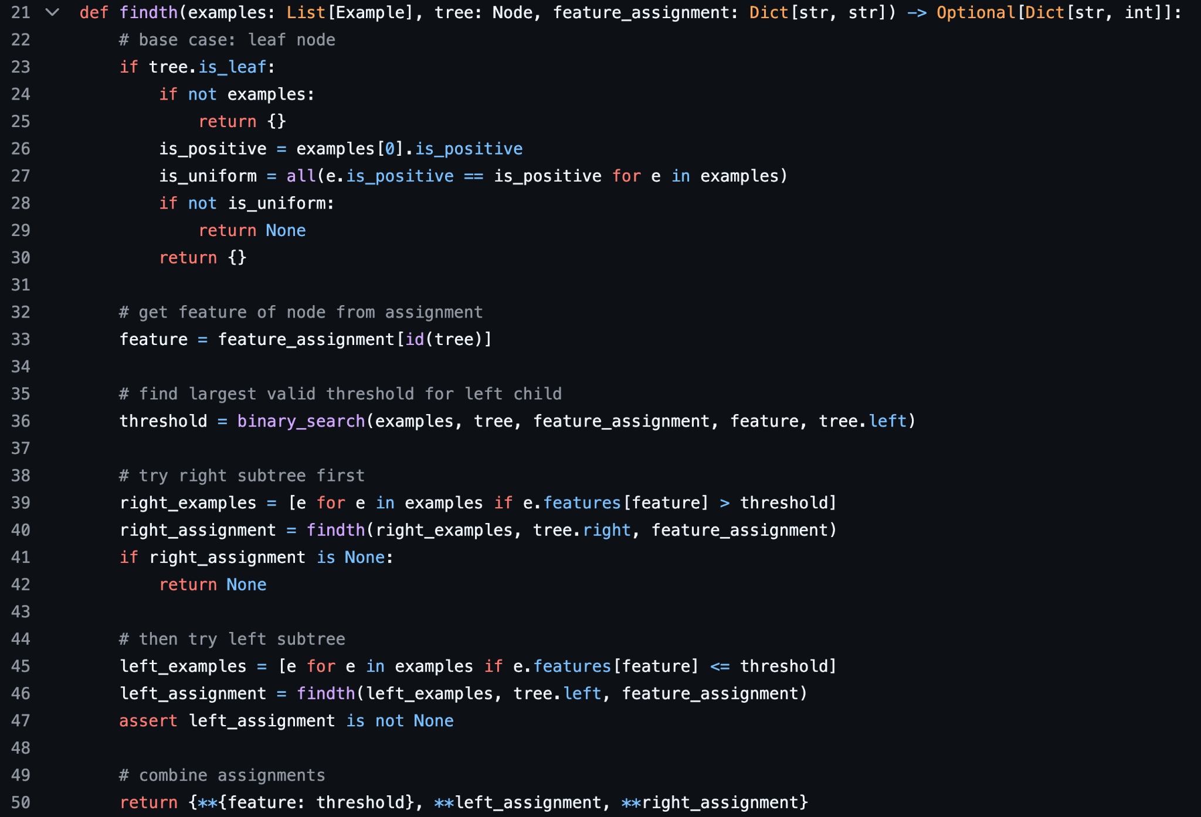
input:
- tree structure
- feature assignment for
each test node
output:
- threshold assignment
for each test node
choose largest threshold
to minimize entropy
= monotonicity property
of thresholds
validation
on right child

Slide 25
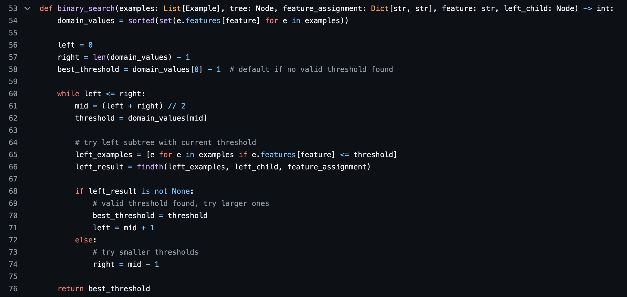
recursively expand
on left child only

Slide 26
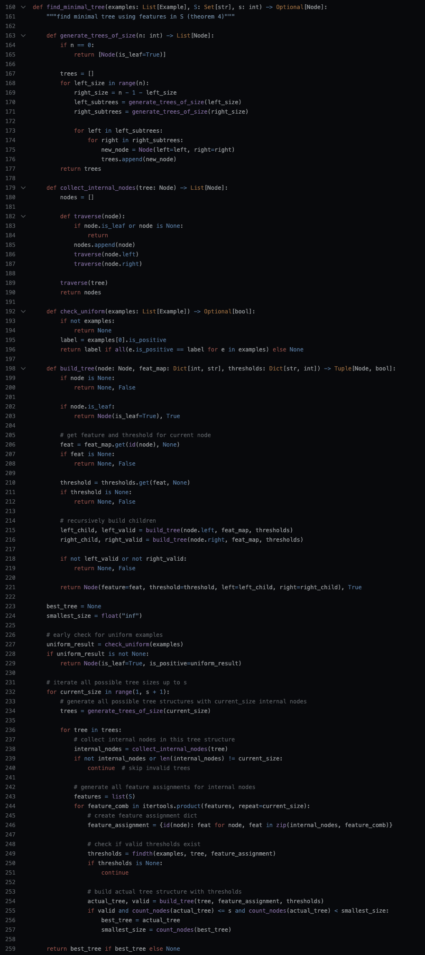

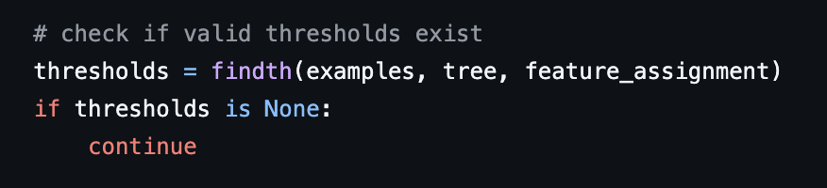
enumerate all possible:
- tree structures
- node feature assignments
given a set of features.
validate each combination.

Slide 27
1) feature selection
- input: examples, tree size
- output: minimal tree (or null)

Slide 28
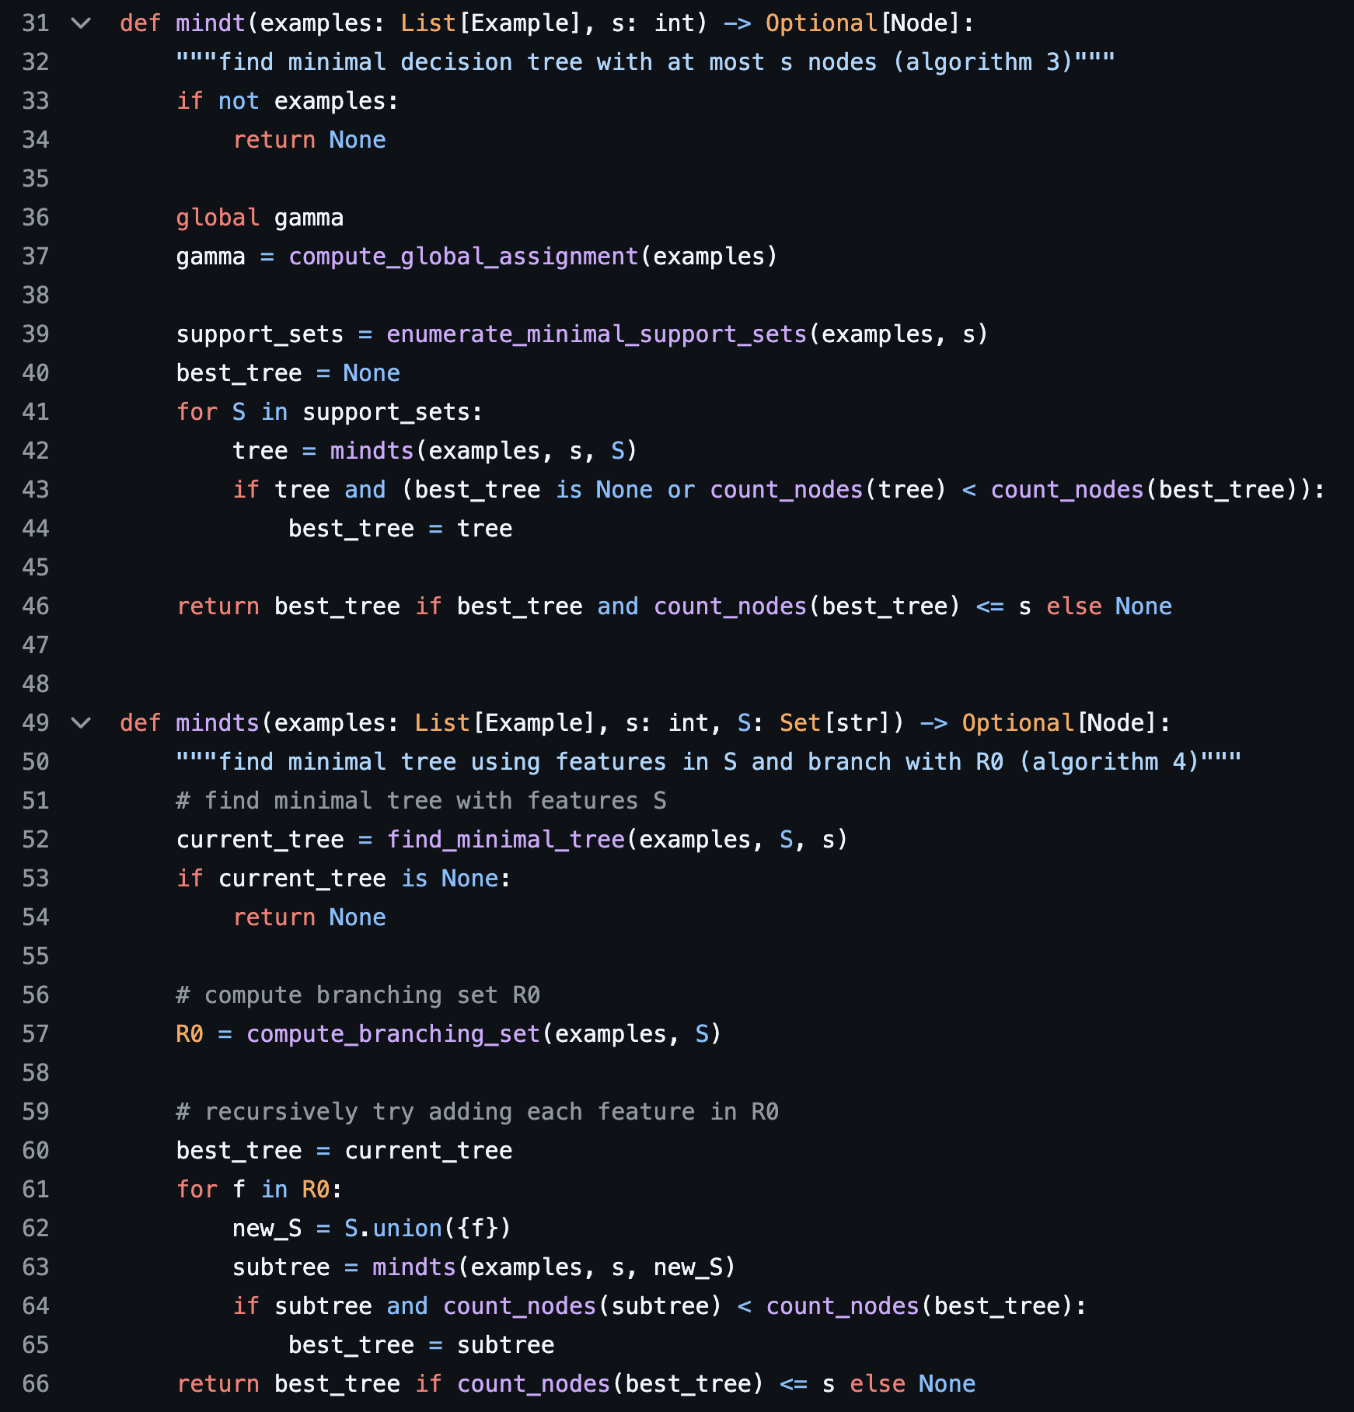
ignore for now
all possible feature combinations
that can distinguish most examples
check if tree exists (see first stage)
add “additional features” that help distinguish all examples.
find the “greatest common denominator” among all “additional features”,
called “branching set / R0”

Slide 29
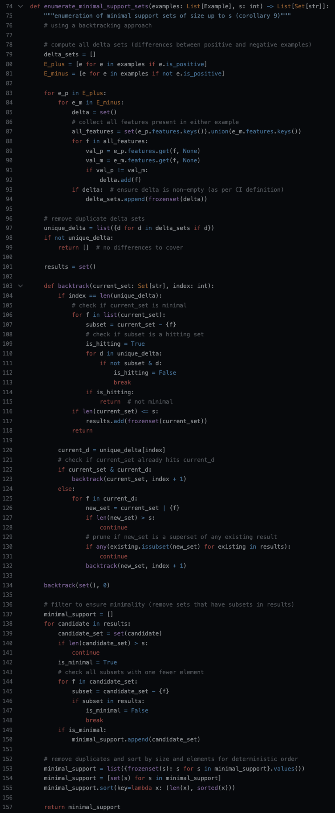

enumerating all possible
mostly distinguishing features

Slide 30
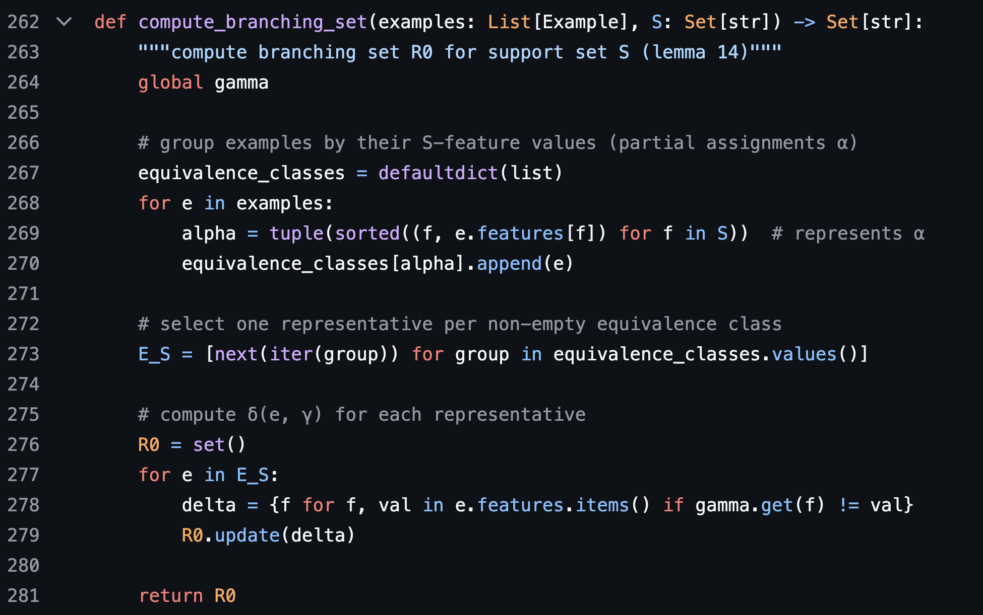
a little hack
to find the “branching set”.

Slide 31
thanks for listening!

